Slide 1

Minnesota Interstate Traffic Volume Analysis
By Gazali Agboola
agboolagazal@gmail.com

Slide 2
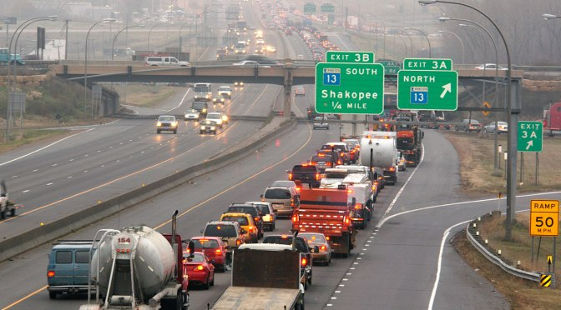

How can insights from data analysis help????
Traffic Congestion is a major problem of many cities.

Slide 3




Data analytics in 3 different charts
01
Monthly traffic Volumes
Monthly traffic patterns’ analysis helps to find the congestion trends monthly
02
Weather cam affect traffic volumes, and the chart will help us understand this effect
Weather
Holiday
Traffic congestion varies in different holiday.
03

Slide 4
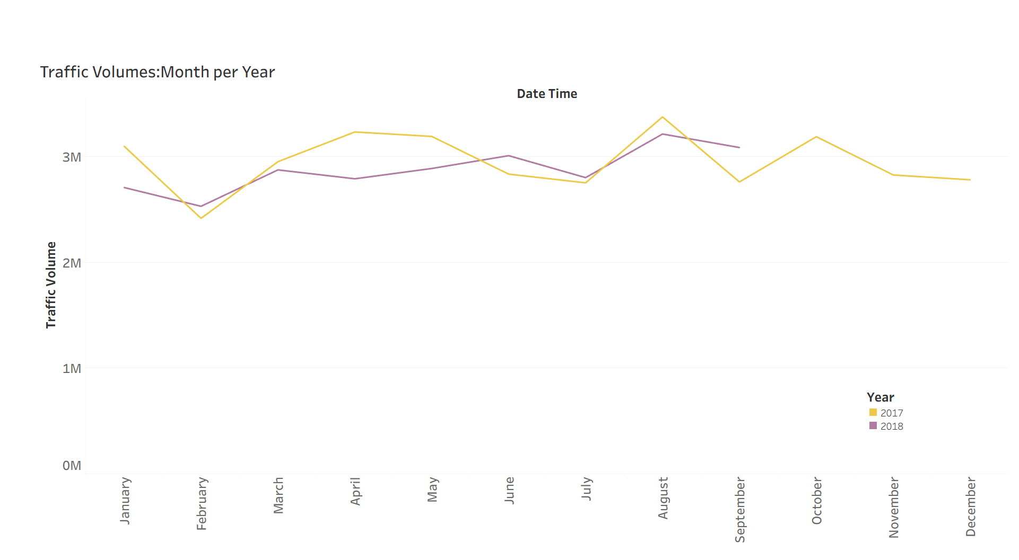

Monthly traffic volumes
📈 August – Peak traffic volumes, aligned with late-summer seasonal travel
📉 February – Lowest volumes, best time for construction or roadway maintenance
⚠️ April 2018 – Notable dip in traffic, potential anomaly or special event impact
Consistent and predictable seasonal traffic patterns observed year over year

Slide 5
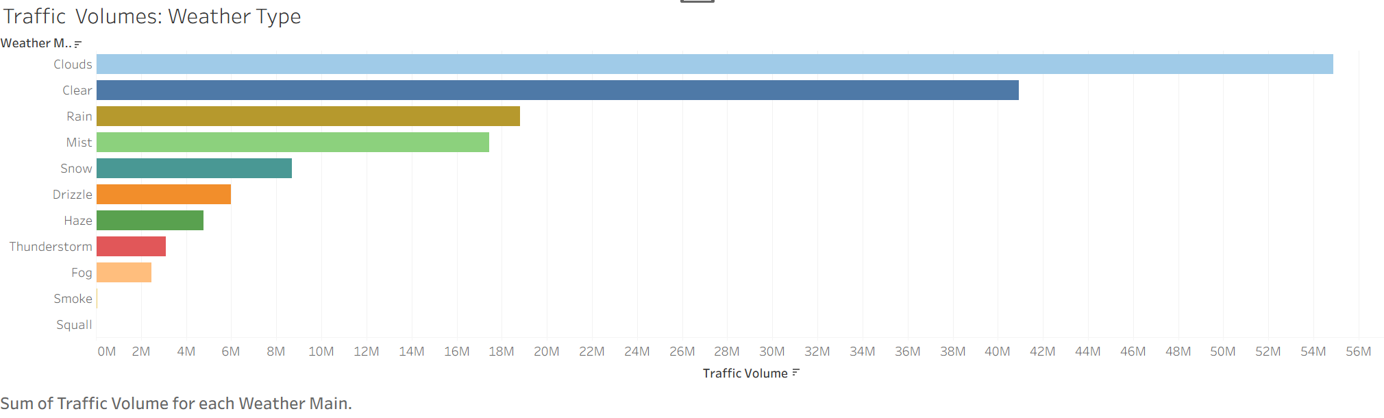
Do weather conditions affect traffic ?
🌥 Clouds & Clear Skies – Highest traffic volumes, indicating motorists are most active in normal conditions
🌧 Rain & Mist – Surprisingly, high traffic continues even during precipitation, though overall volume drops.
❄️ Snow & Extreme Weather – Noticeable decline in traffic; drivers avoid travel in hazardous conditions.
⚡ Severe Events (Thunderstorms, Fog, Smoke) – Lowest volumes, strong deterrent to travel.

Slide 6
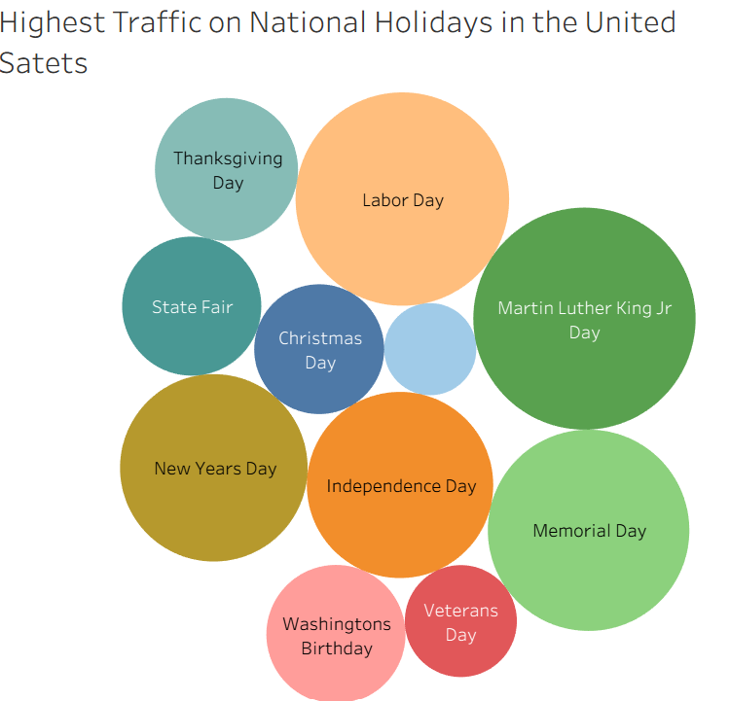
The impacts of holidays on traffic congestion
🎉 January Holidays Drive Spikes – New Year’s Day and Martin Luther King Jr. Day account for most of January’s elevated traffic
📅 Labor Day & Independence Day – Among the highest single-day traffic volumes due to travel and celebrations.
🍂 Thanksgiving & Christmas – Noticeable impact but lower compared to summer holidays
⚖️ Most holidays show only modest influence on total traffic volumes

Slide 7
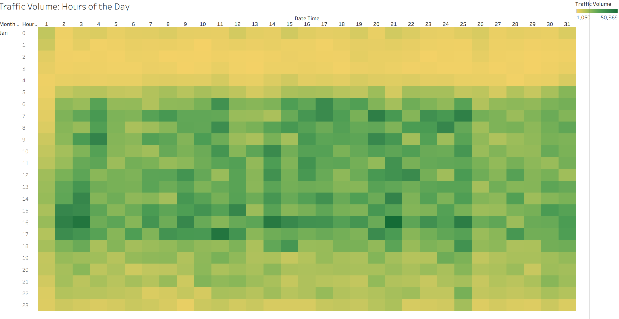
Hourly Traffic Congestion
⏰ Morning Rush (6–9 AM) – Strong increase as commuters head to work/school
🌆 Evening Rush (4–7 PM) – Peak congestion hours, with the highest volumes around 5–6 PM
🌙 Late Night (10 PM–5 AM) – Minimal traffic, consistent across all days
📅 Weekday Patterns – Predictable surges tied to work schedules; weekends show flatter trends

Slide 8
Thank You

